Slide 1
Posts

Slide 2
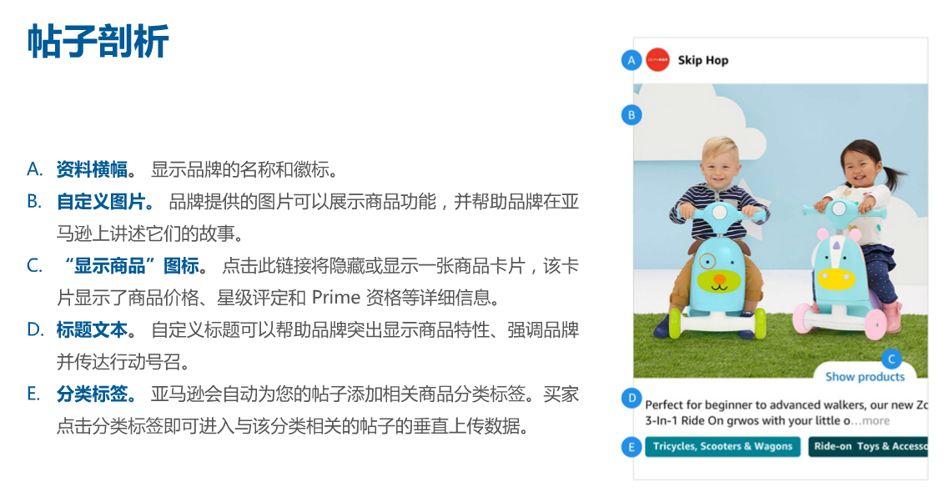
Posts Overview

Slide 3
创建posts的禁与行
禁止：
帖子标题和图片不得相互矛盾。Eg:狗粮的帖子指向猫的商品
避免重复相关商品详情页已有的内容，如文本和图片。
提供单个白色背景的品牌徽标或徽标组合
包含拥挤、过量、剪裁不当或无法辨识的元素
包含“立即购买”等行动诏令
通行：
帖子可以包含简写词语，主题标签和表情符合。Eg: #woman party dress#
展示相关背景或生活场景中的商品或品牌
支持上传中的常见比例（eg: 1*1, 16*9, 4*3)的图片，格式JPG或PNG
分辨率：640*640像素或更大，最大文件大小：100MB

Slide 4
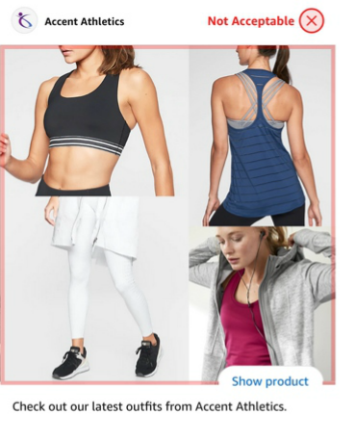
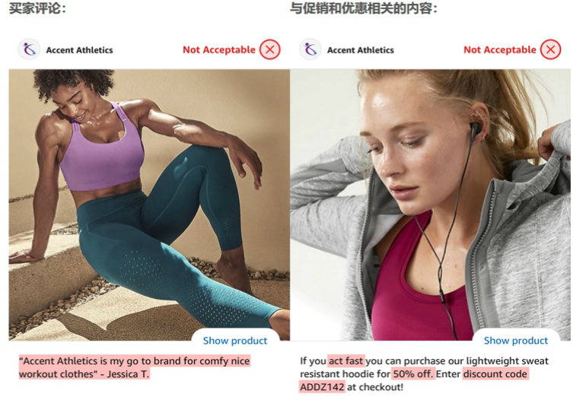
Posts 不合格案例
图片拥挤
包含买家评论
包含促销信息

Slide 5
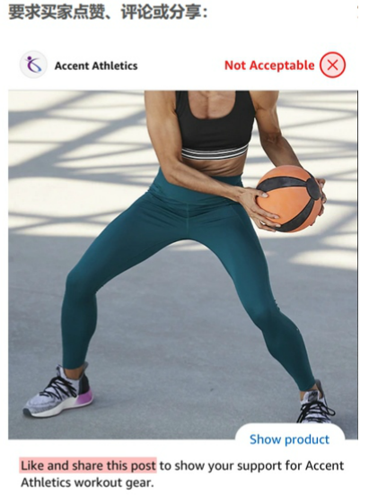
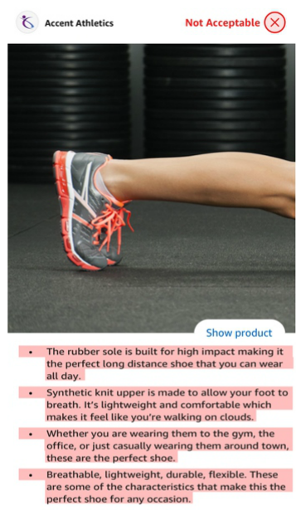
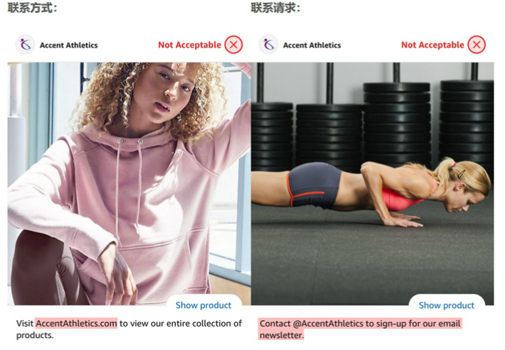
Posts 不合格案例
要求买家评论、分享
留联系方式或联系请求
照搬5点描述

Slide 6
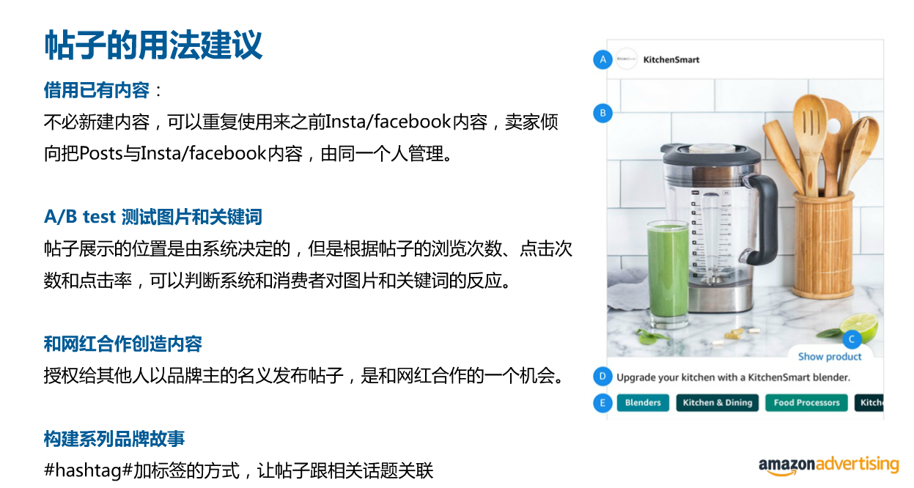
帖子的用法建议

Slide 7
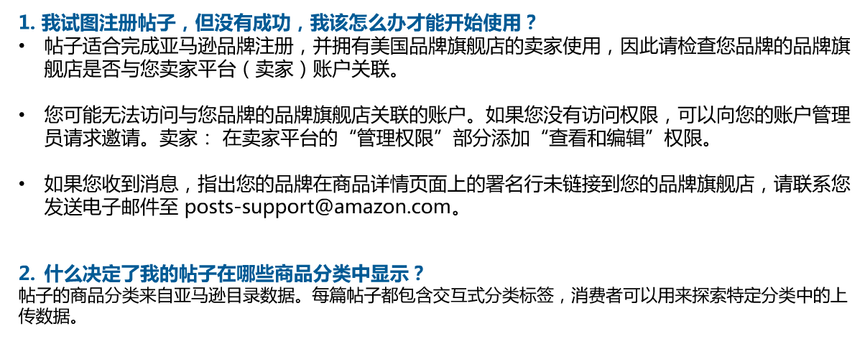
创建Posts 常见问题

Slide 8
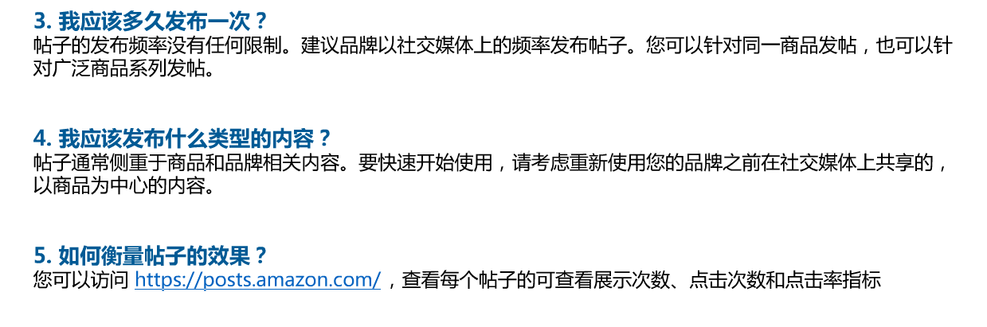
创建Posts 常见问题

Slide 9
Post Update (US)
POSTS UPDATE: Product detail page carousels now show the most recent and highest-performing related posts, regardless of brand affiliation. We no longer support the brand-owned carousel on detail pages.
Seller Voice:
Top placements of related posts are competitors rather than brand-owned.
Learnings:
Why it happened?
Check two factors. First, check it if the ASIN is in stock. If it is out of stock, posts will not show up. Second, check the post performance, indicating your posts need optimize. With updated information, AM will know that Amazon system will optimize placement of your posts based on detail page relevance, recency, and customer engagement. If your posts perform not very well, there will be other competitors’ posts under your sellers’ ASIN detail page and may ahead of yours.
What sellers can be done to help optimize posts?
Based on latest posts rule, please pay attention to each created posts instead of leaving them alone.
If your ASINs are out of stock for a while, please check posts placements or create the newest related posts when in stock to make sure they are at the top placement.
When optimizing your posts, suggest DO NOT delete old posts since old posts accumulate impressions. In addition, good keywords and high quality photos are good for increasing your CTR
Maintain and create posts regularly.

Slide 10
Post Update (US)
Other FAQ:
Q: I published my first post. The dashboard says it’s live, but it’s not showing up on my brand’s detail pages. Is there anything else I need to do in order for my post to show up?
A: Amazon requires that brand’s publish a minimum of three posts before we’ll start displaying your content on detail pages. This helps ensure customers can swipe through the horizontally-scrolling carousel on detail pages.
Q: I’ve published three or more posts, but I’m still not seeing the carousel. What’s wrong?
A: We do not display posts for products that are out of stock or where the brand owner isn’t winning the buy box. If you’ve published three or more posts and your still not seeing your carousel displayed on detail pages, check the ASINs for your posts to make sure that the products they link to are in stock and that you’re winning the buy box for a minimum of three or more of your posts. If not, you’ll need to publish posts for three or more products that meet these criteria.
Q: When I want to publish new posts, should I edit my existing ones, or create new ones?
A: There’s no limit to the number of posts you can publish. Therefore, we encourage brands to always create new Posts rather than edit existing ones. Additionally, we encourage brands not to withdraw posts they’ve previously published, unless they need to do so. Our systems will optimize placement of your posts based on detail page relevance, recency, and customer engagement.
Post Basic Info: https://advertising.amazon.com/zh-cn/lp/beta-posts

